Slide 1

Rantasalmi
High School
2025 - 2026

Slide 2

Rantasalmi – ”naturally sustainable”

Slide 3

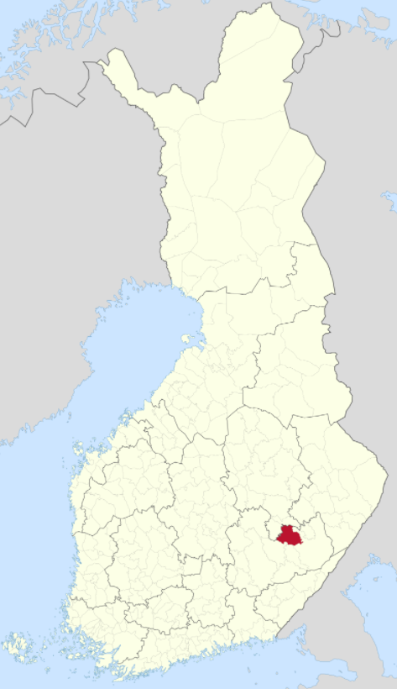
Rantasalmi
Small and beautiful village by lake Saimaa
3350 inhabitants
Savonlinna and Varkaus are the nearest cities (42km)
321km from Helsinki (bus/train to Savonlinna)

Slide 4

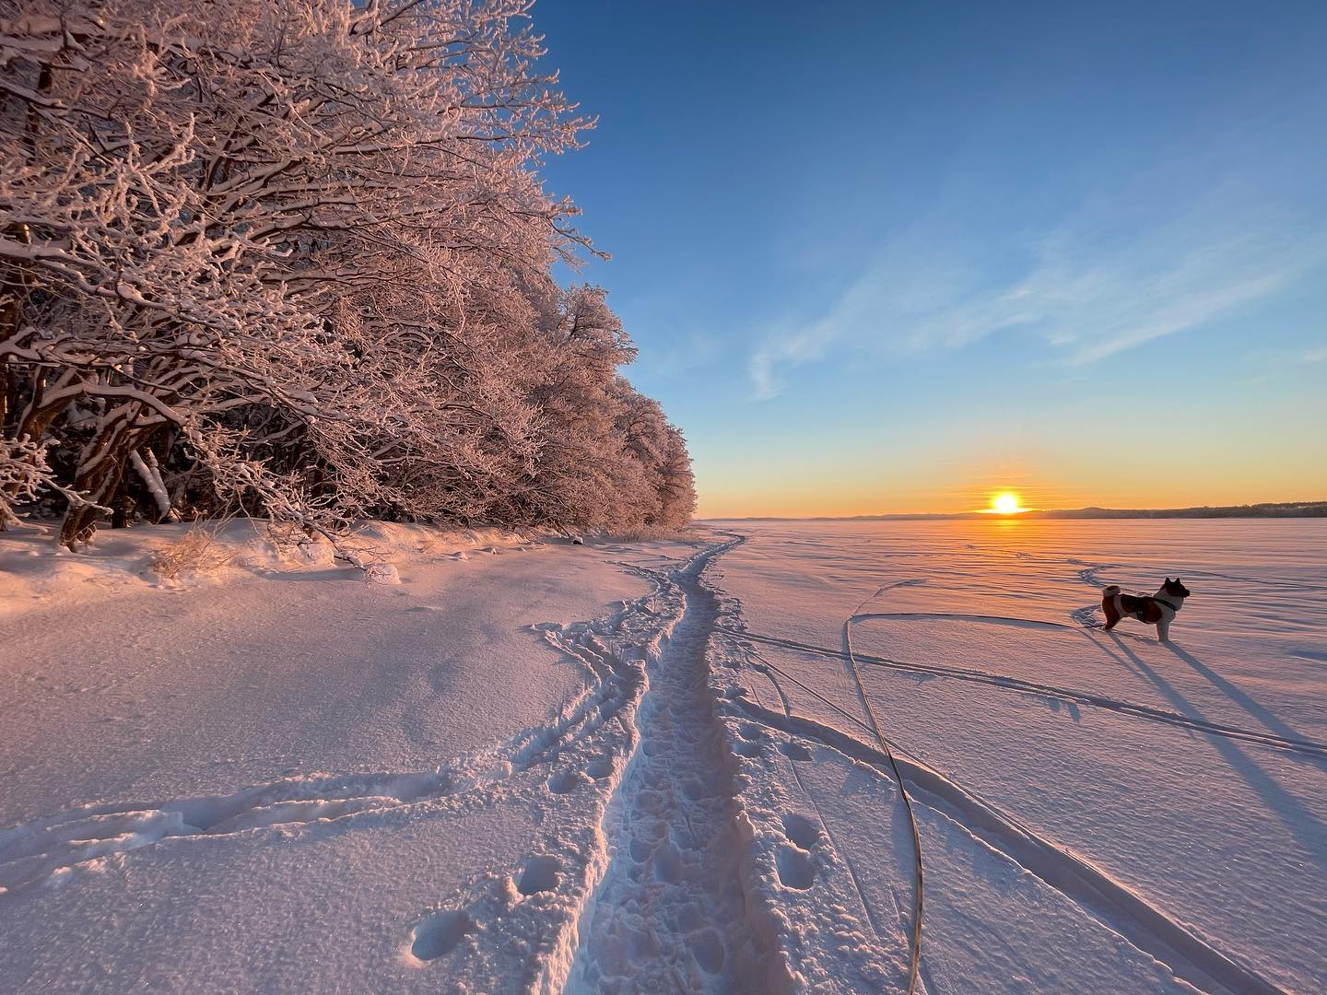

Slide 5
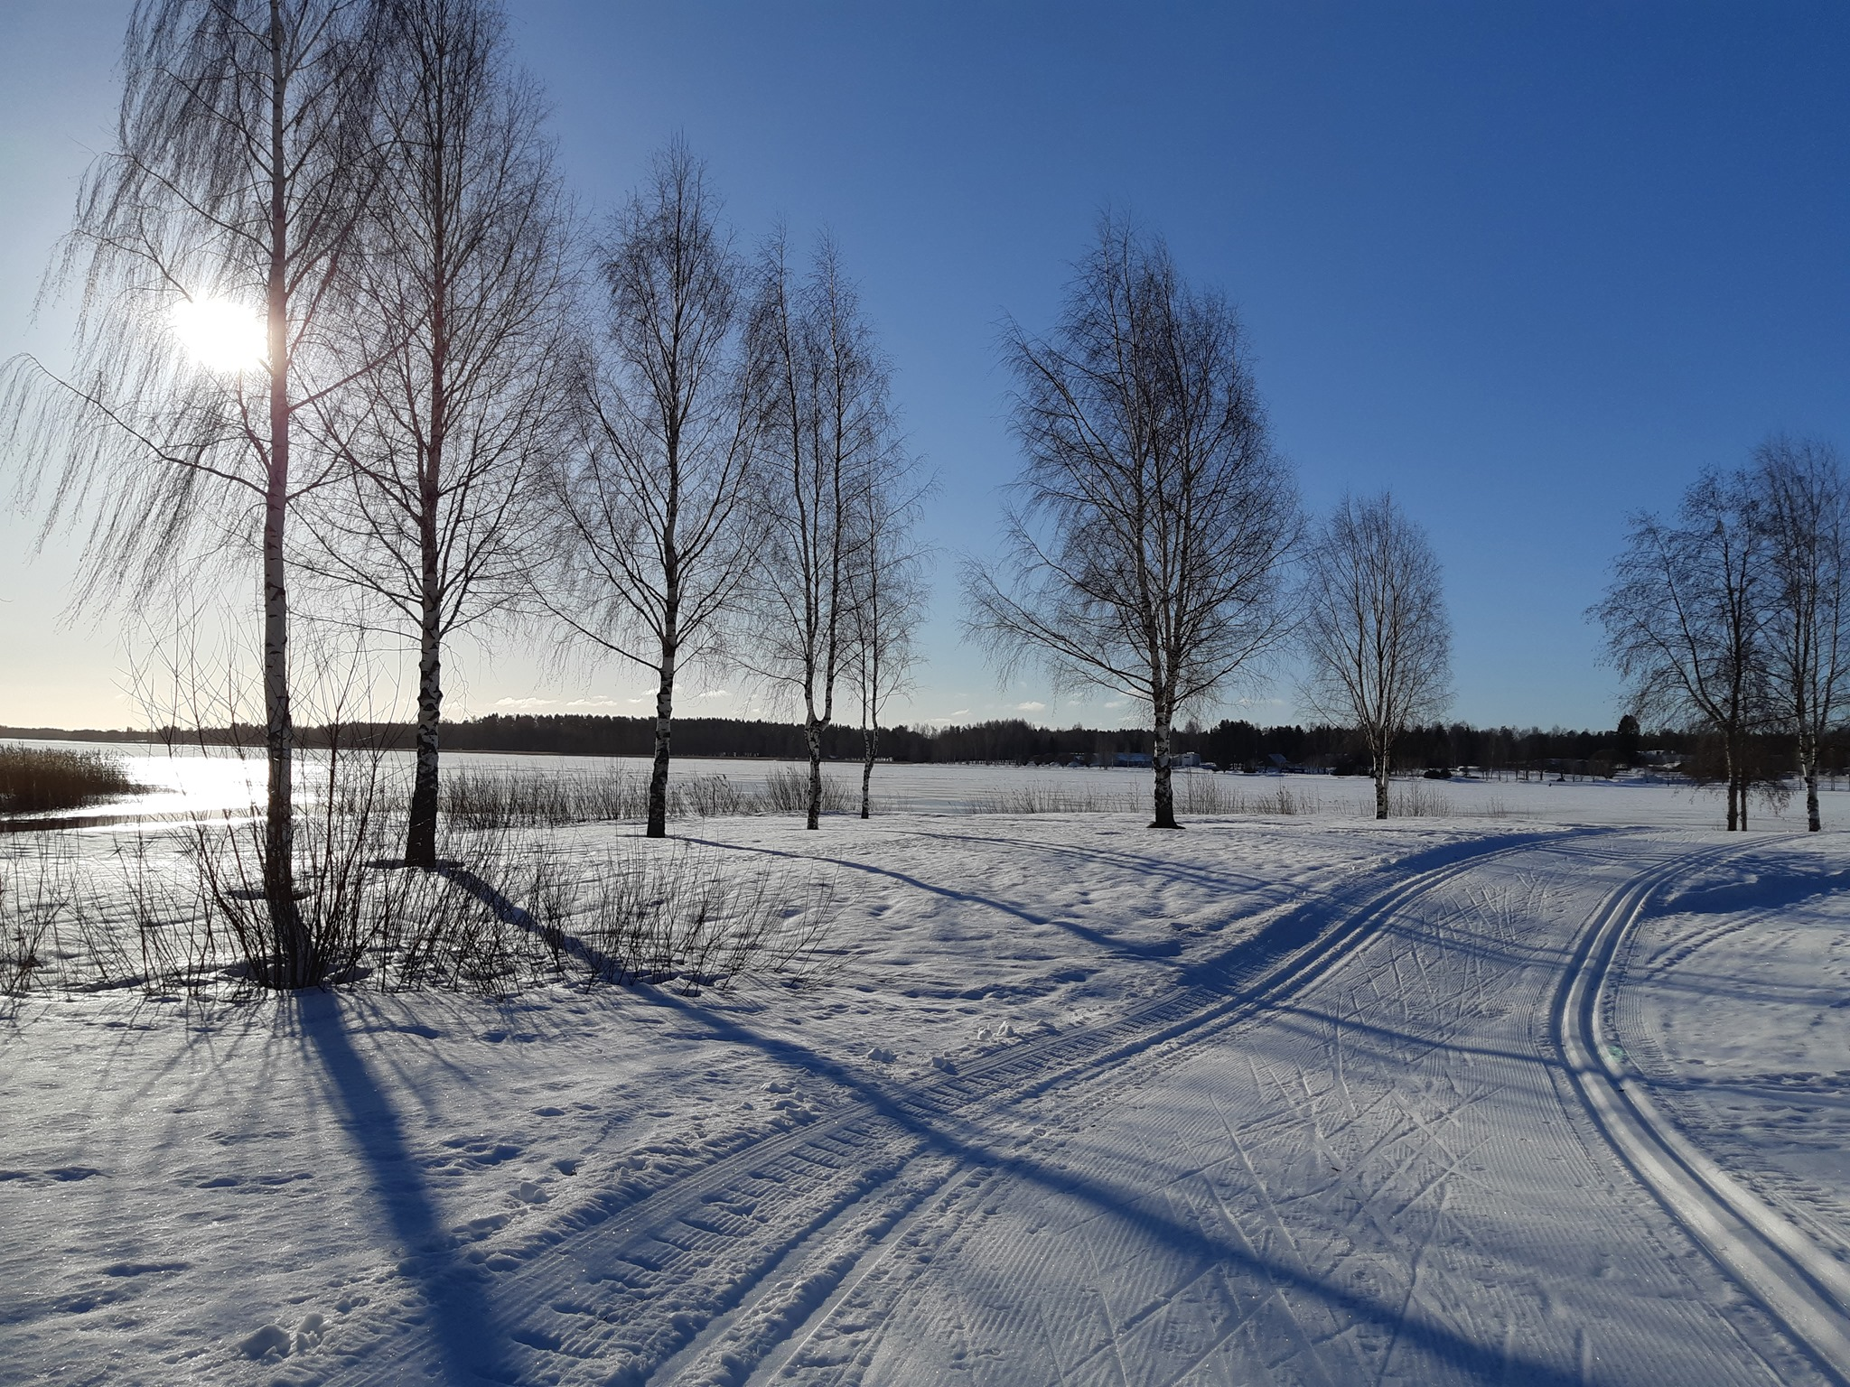

Slide 6
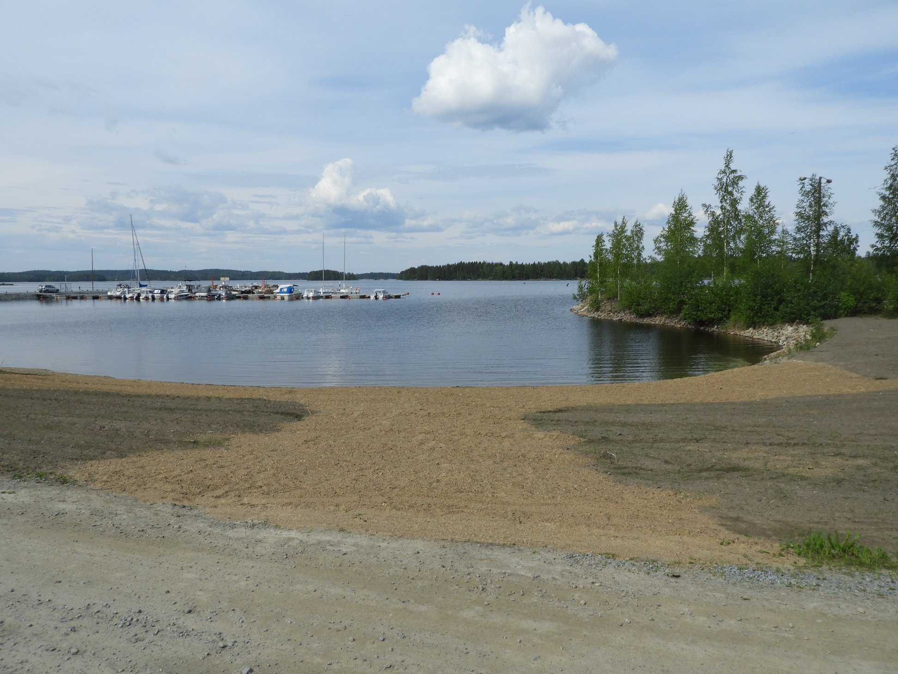

Slide 7
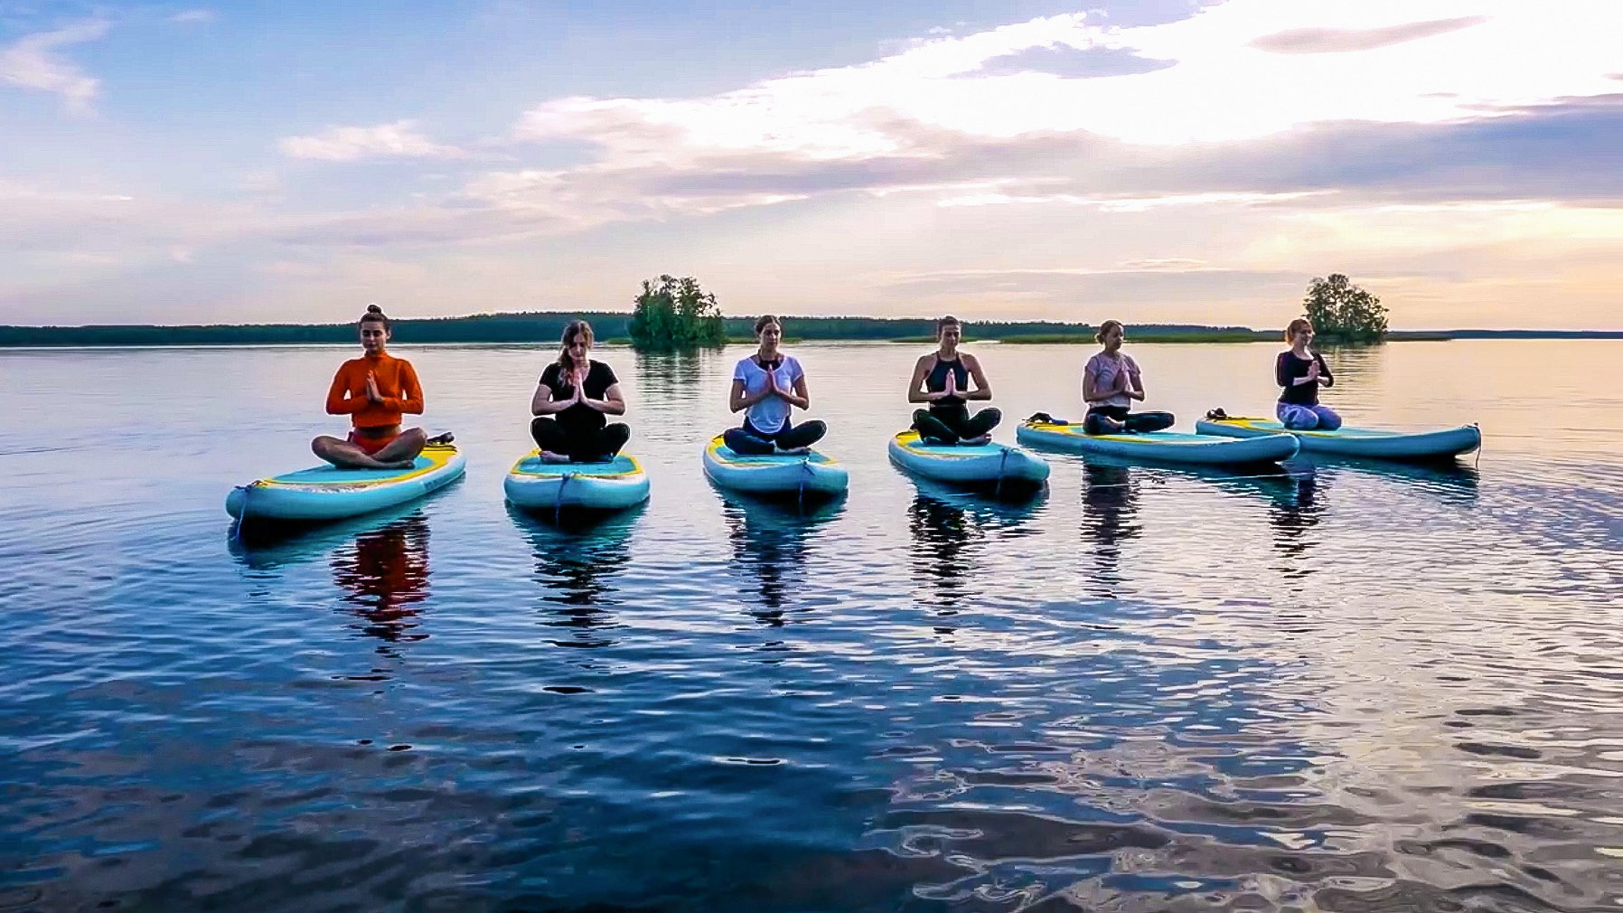

Slide 8

Rantasalmi High School
Small school: ca. 70 students
One third of students come from other towns
Every graduate will get a grant of 500 euros
Rantasalmen lukio

Slide 9

Lines of study
General High School
Music Theatre
Studio Technique

Slide 10
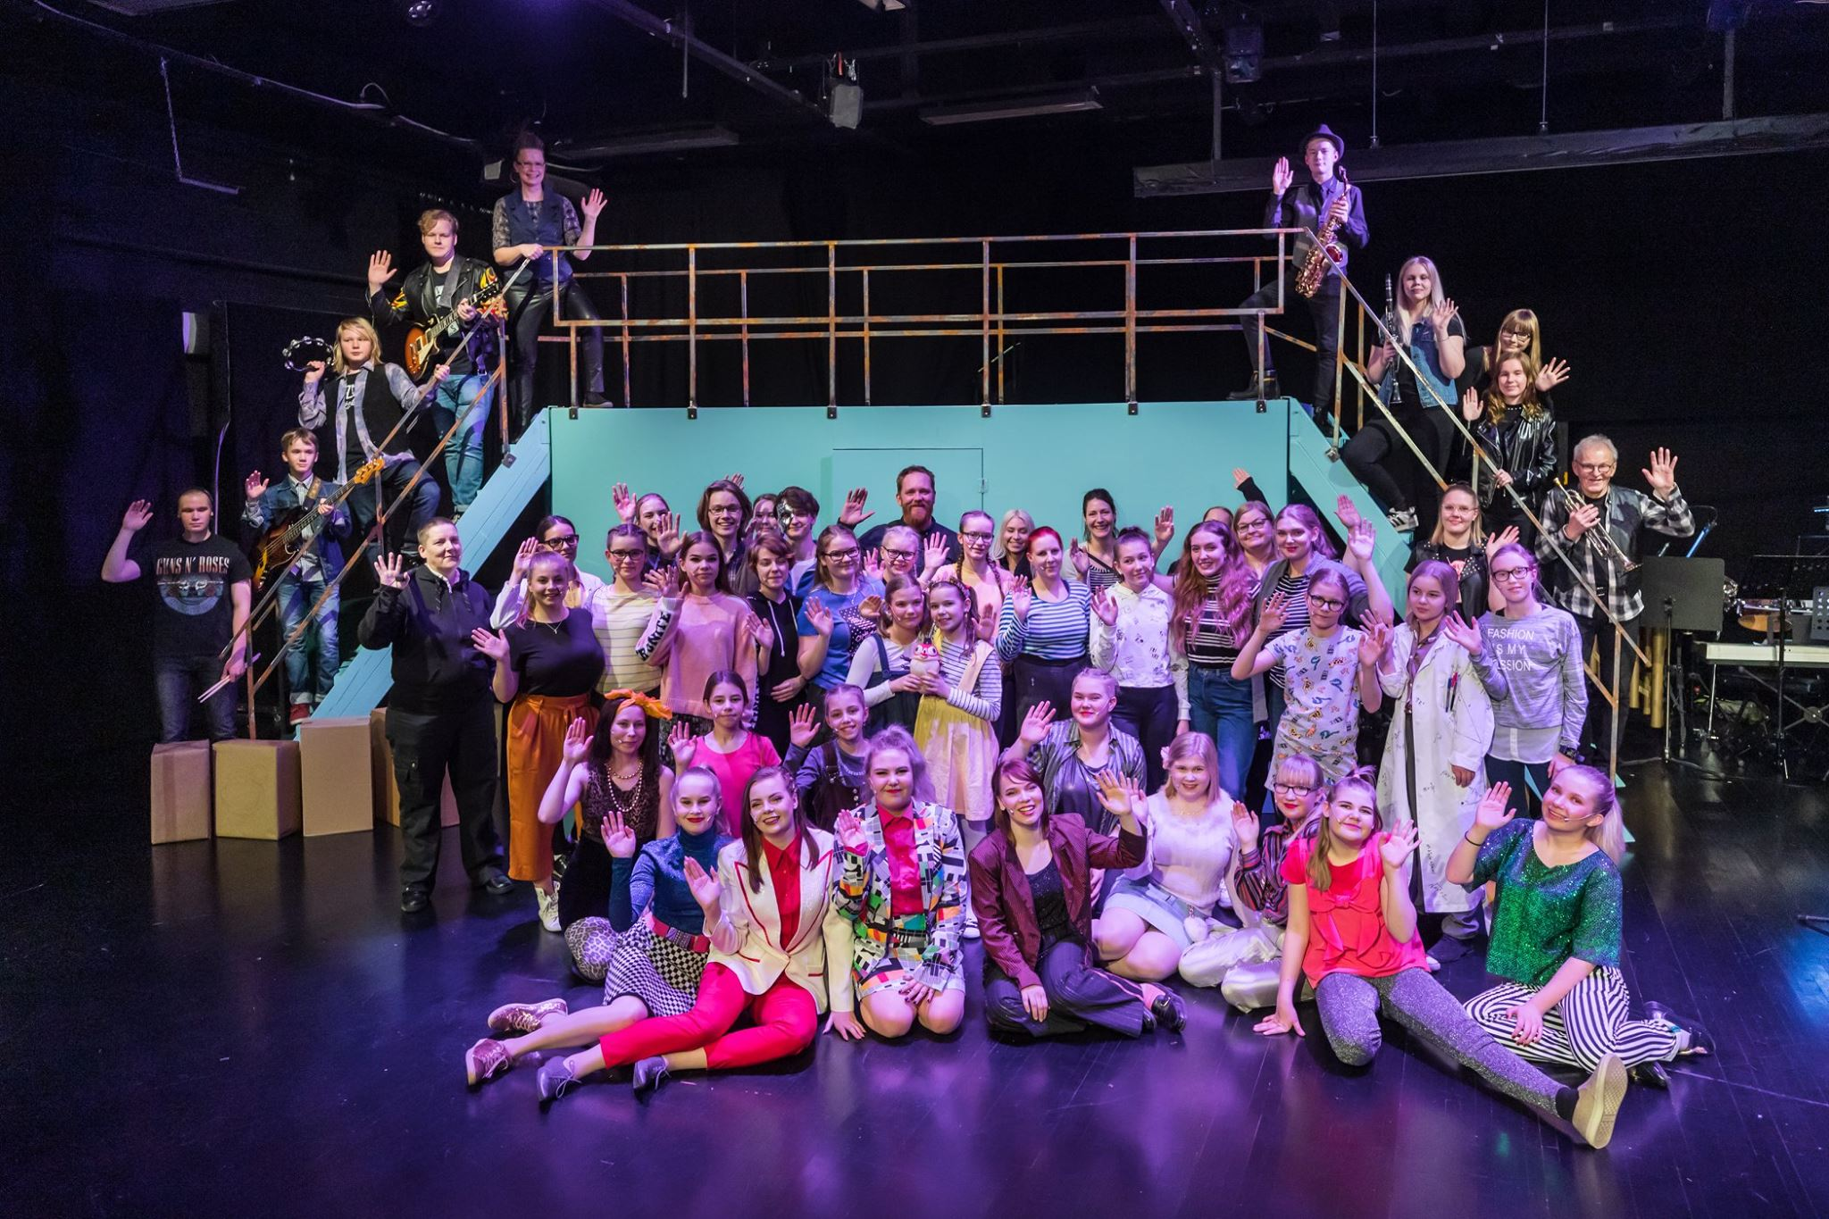

Slide 11
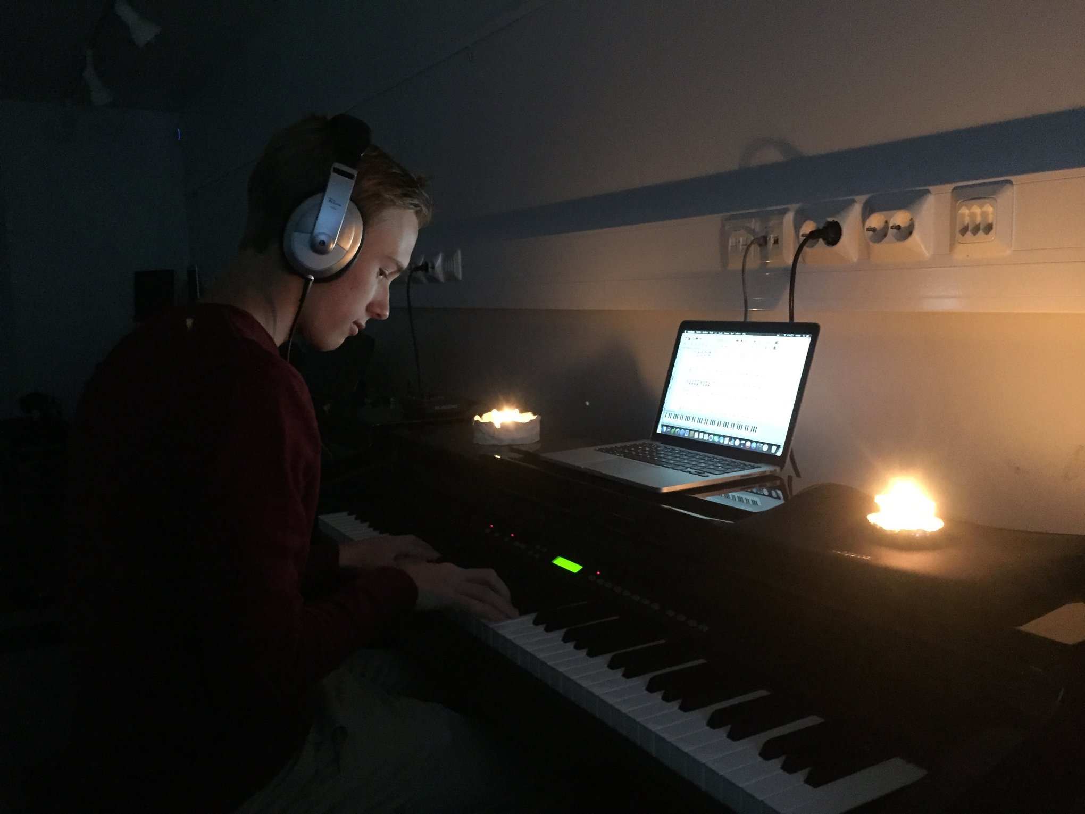

Slide 12
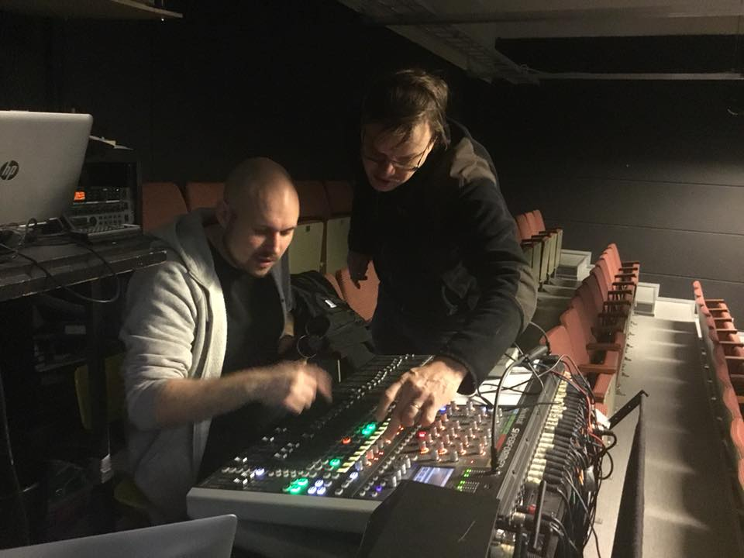

Slide 13
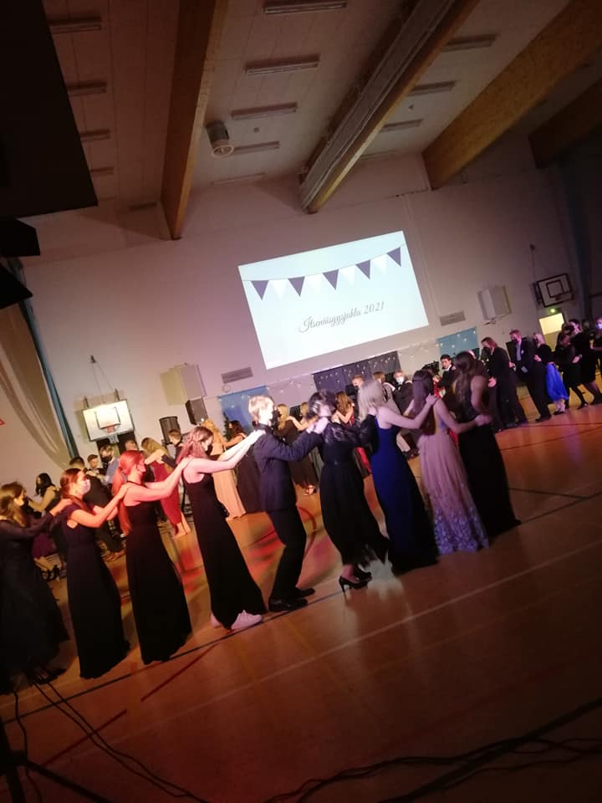

Slide 14
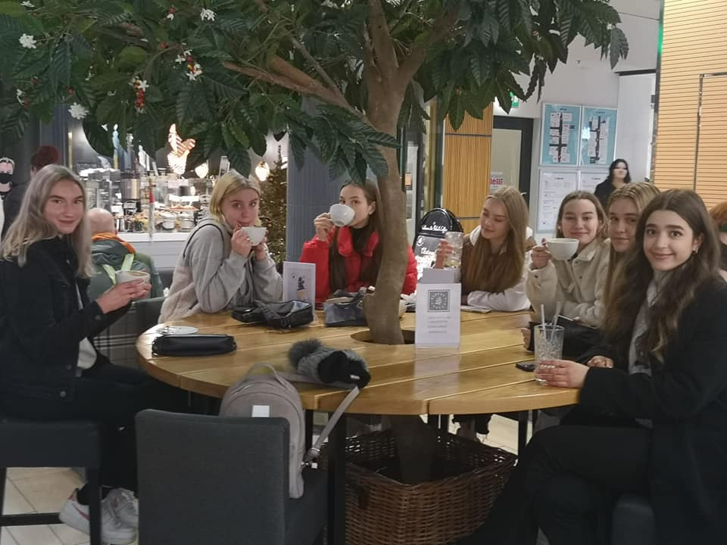

Slide 15
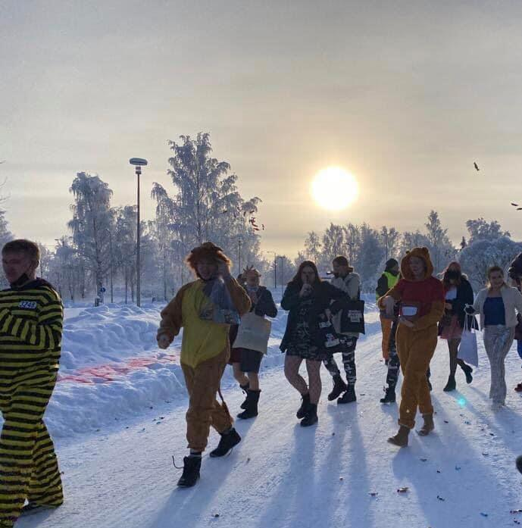

Slide 16
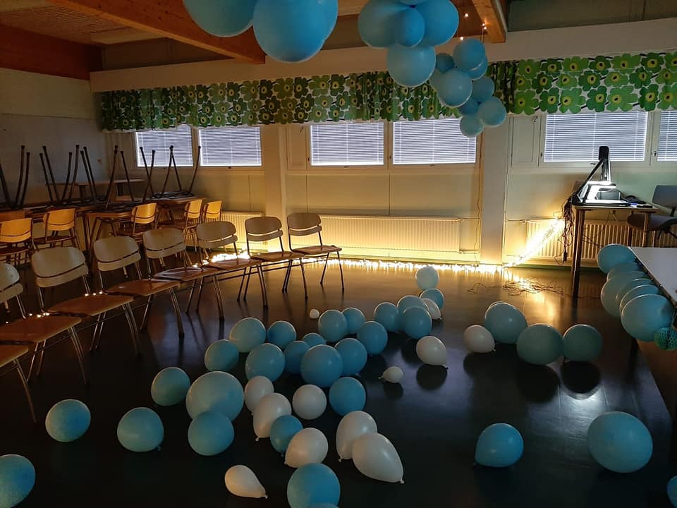

Slide 17
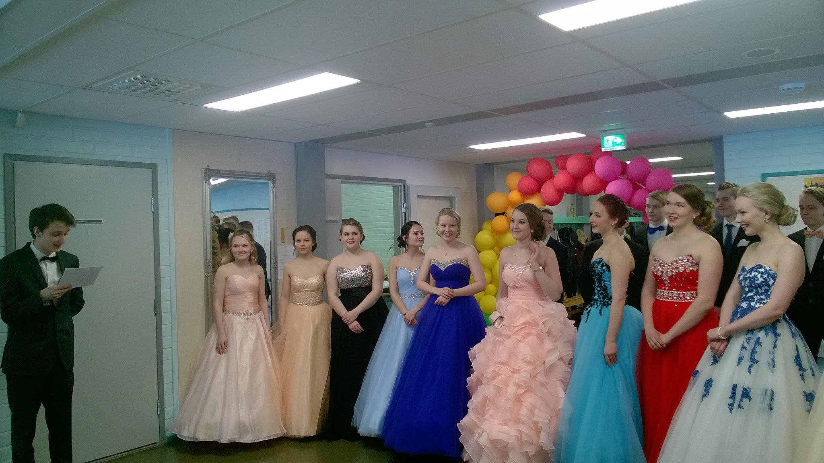

Slide 18

The subjects
At every high school you must study: Finnish, English, mathematics, physics, chemistry, biology, geography, history, psychology, philosophy, social studies, religion or ethics, health education, visual arts, music, physical education
At our school you may choose extra subjects: music theater, studio technique

Slide 19

Student support
Remedial instruction is available
Study counselor, school social worker and school nurse work in the high school building
School psychologist is available

Slide 20

After high school
ANY university is possible to apply
Our graduates study e.g. in Helsinki, Jyväskylä, Oulu, Tampere, Kuopio, Joensuu and Lappeenranta
for example economic science, politics, bioscience, engineering, medicine, pharmacology, first aid, foreign languages, geography, forestry, music, music theatre etc.

Slide 21

Accommodation
Student rooms
3-7 rooms per apartment + kitchen, bath room, (sauna) together, one/two students per room
Very near the school and the center, max 1 km to walk
Possible to have a furnished room – limited number of rooms

Slide 22

Free time activity
Wind orchestra, private lessons in several instruments and singing (for actors)
Gym
Ice rink
Students´own sport groups (etc. floorball, football)
Tennis
Jogging routes
Fitness stairs
Ski paths
Ice skating
Library
Youth house

Slide 23

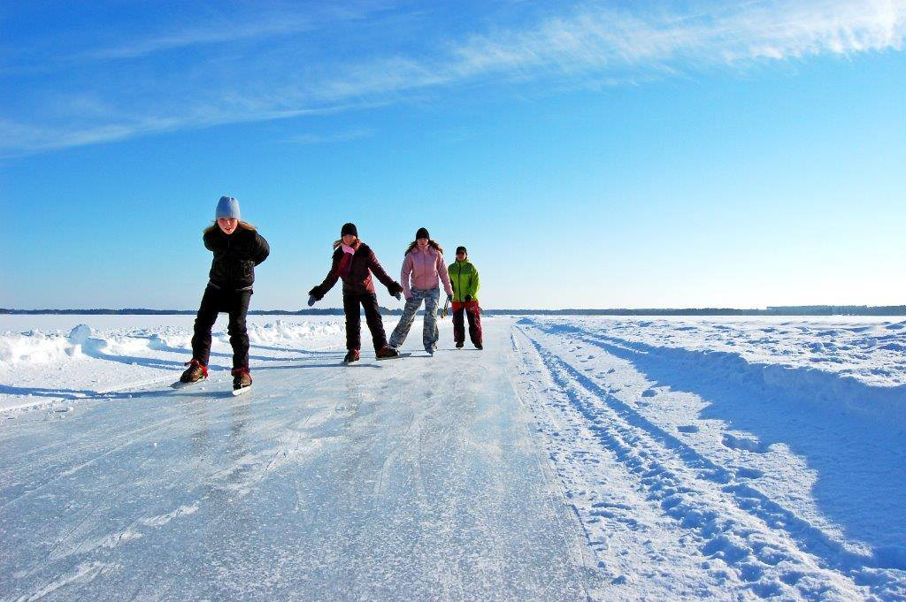

Slide 24
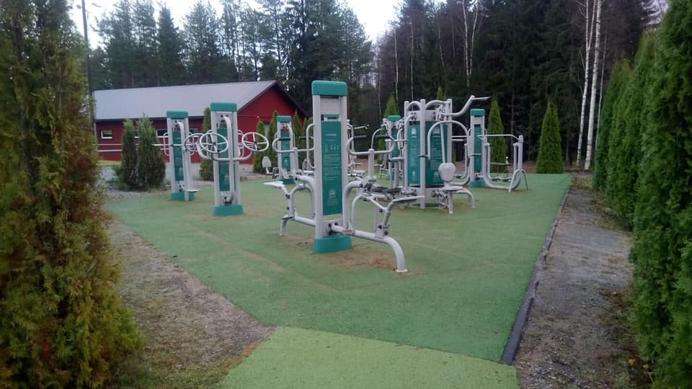

Slide 25
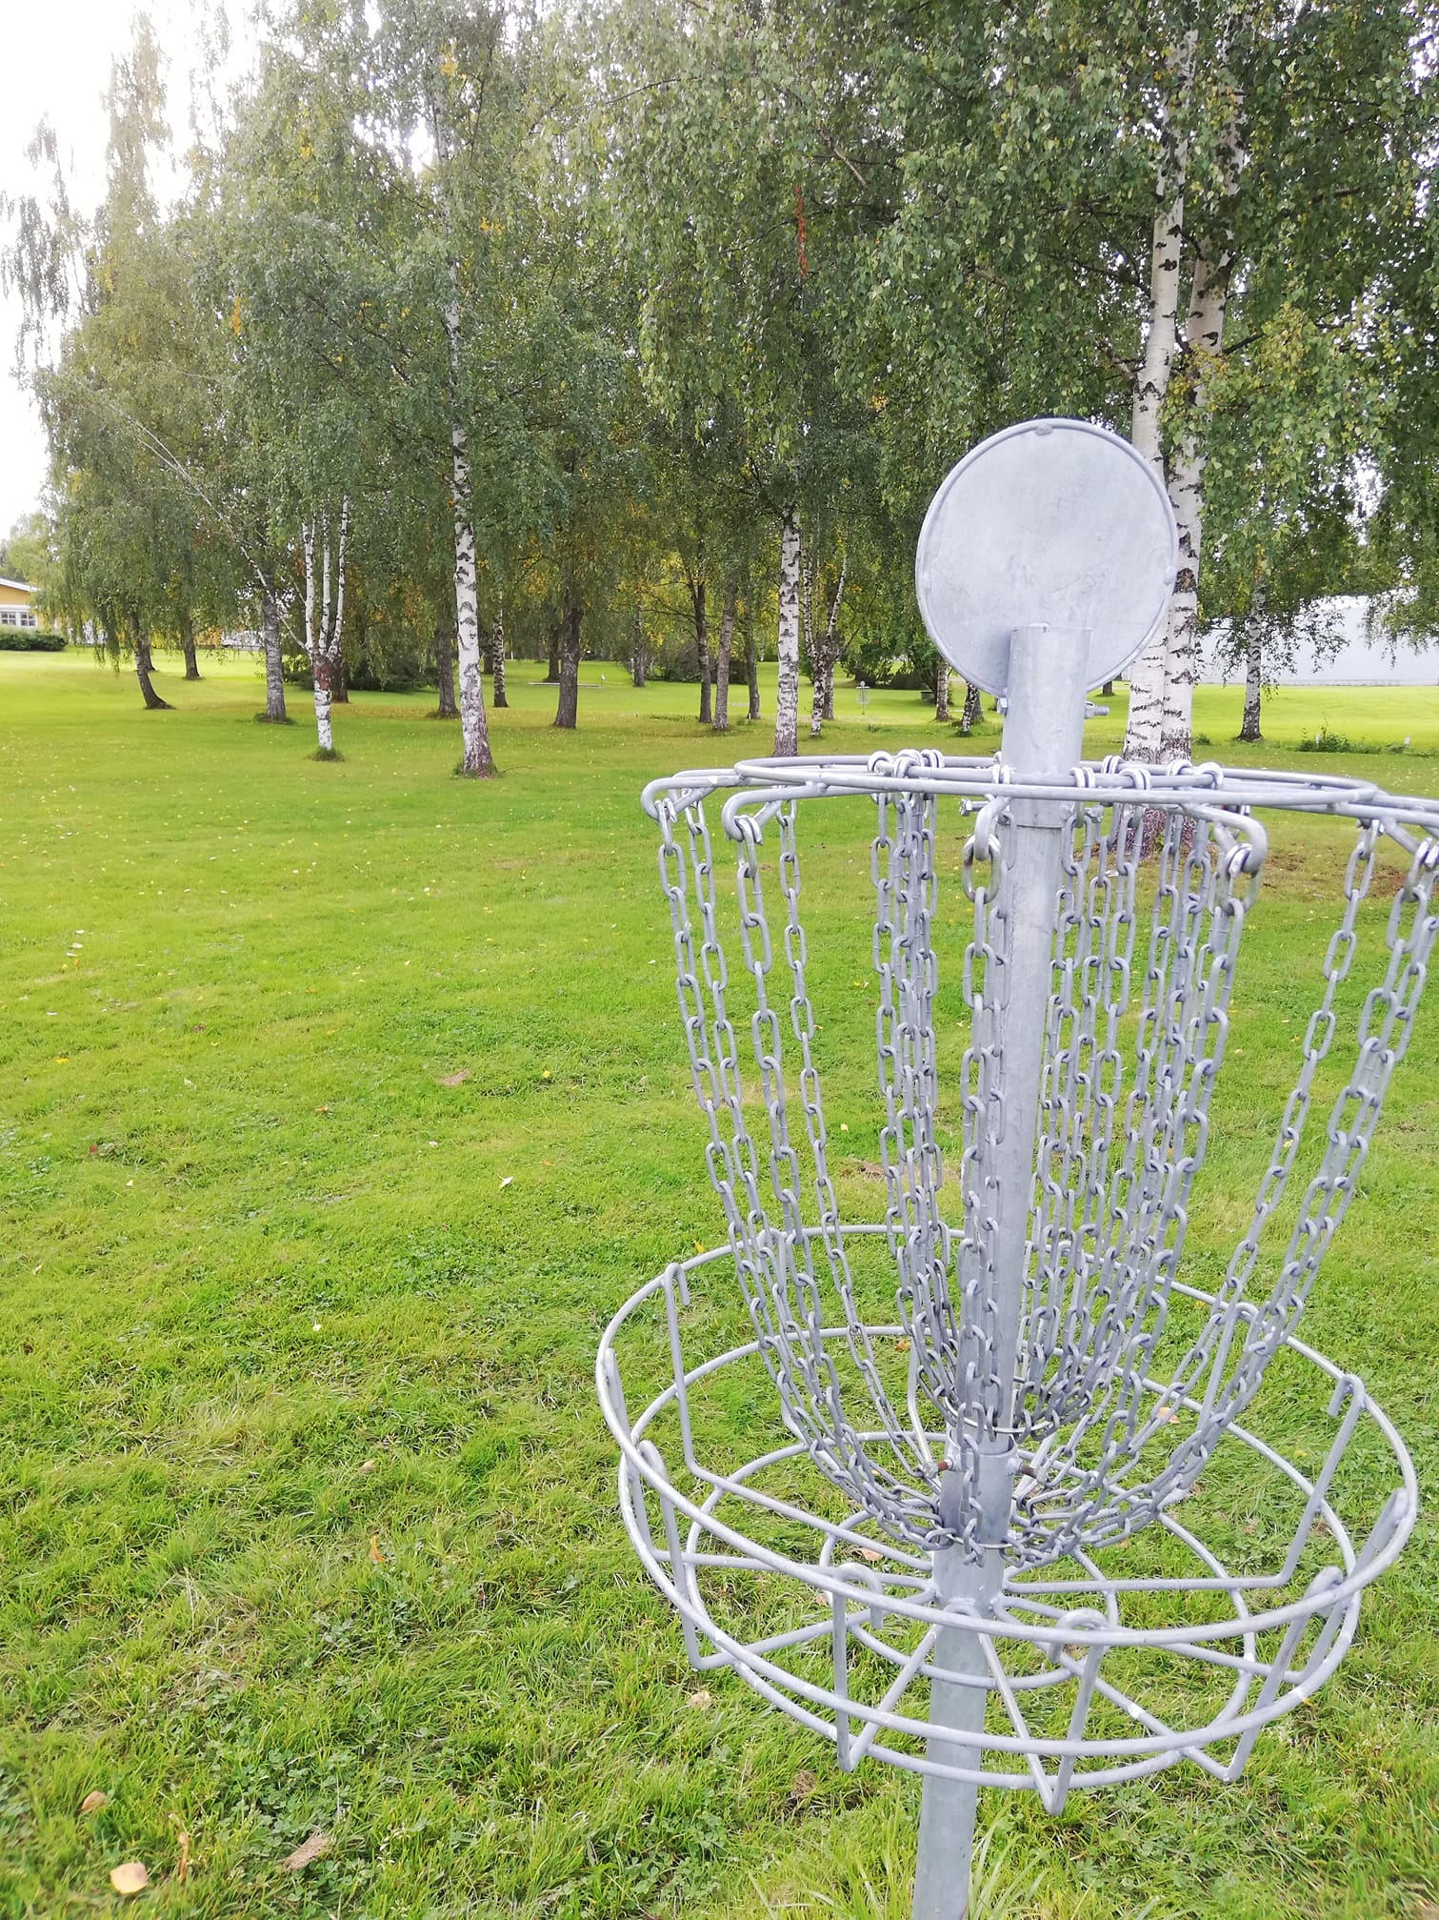

Slide 26
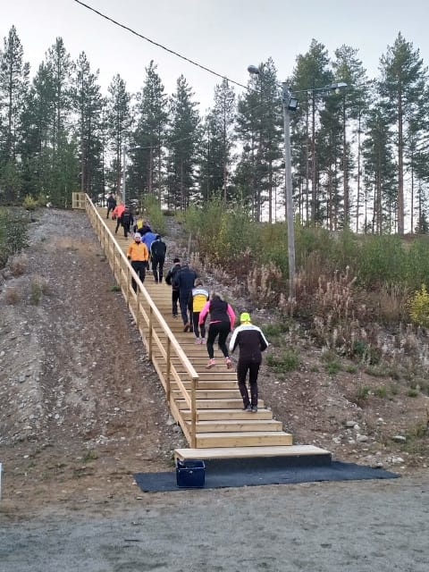

Slide 27

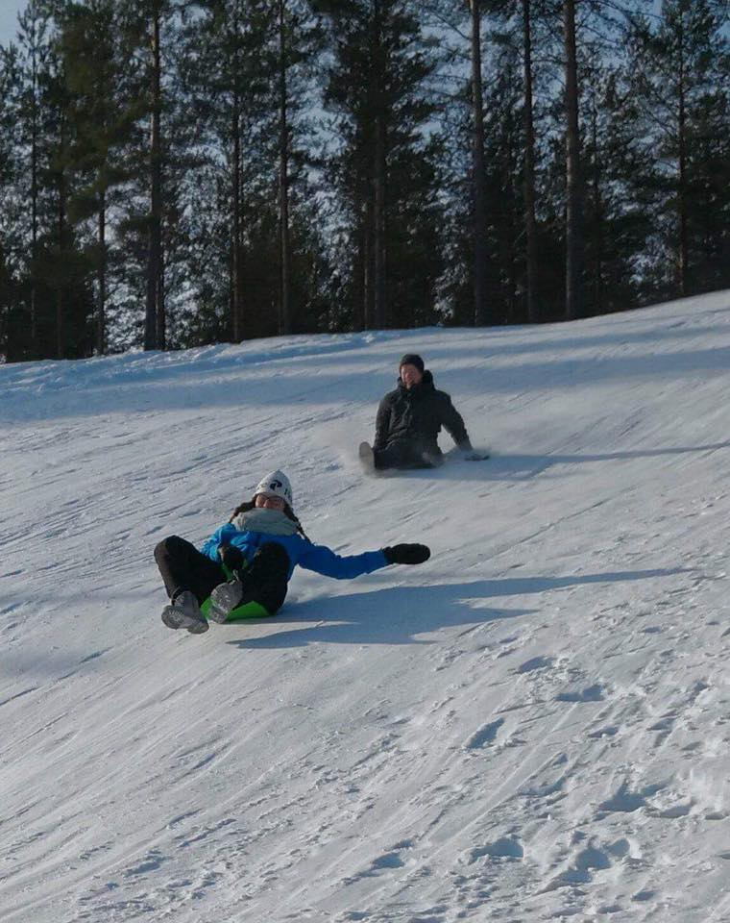

Slide 28


