Slide 1
Rantasalmi High School 2023

Slide 2
Rantasalmi – ”small village, big heart”
Small and beautiful village by lake Saimaa
3350 inhabitants
Savonlinna and Varkaus are the nearest cities (42km)
321km from Helsinki (bus/train to Savonlinna)

Slide 4
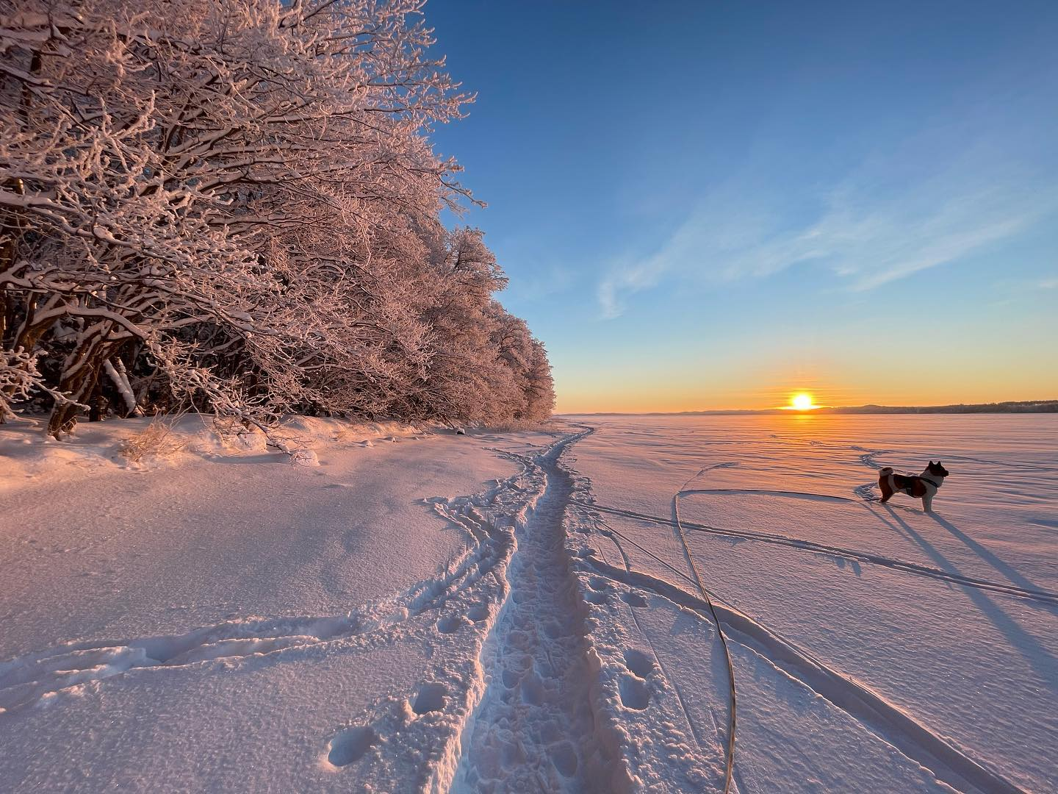

Slide 5
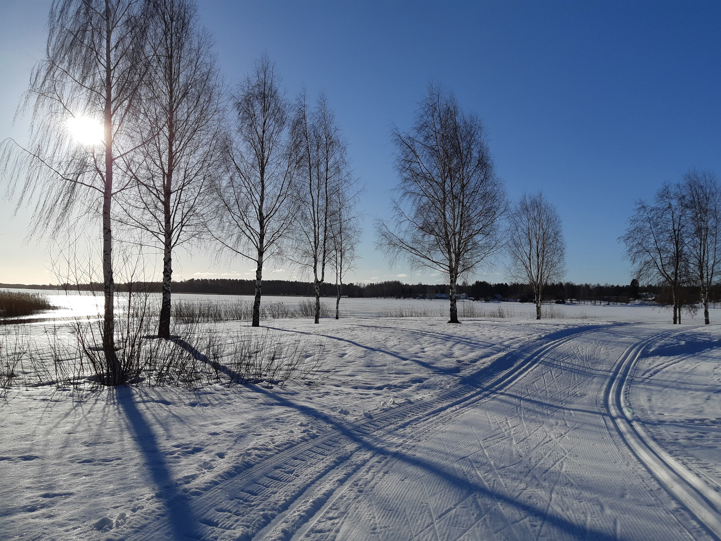

Slide 6
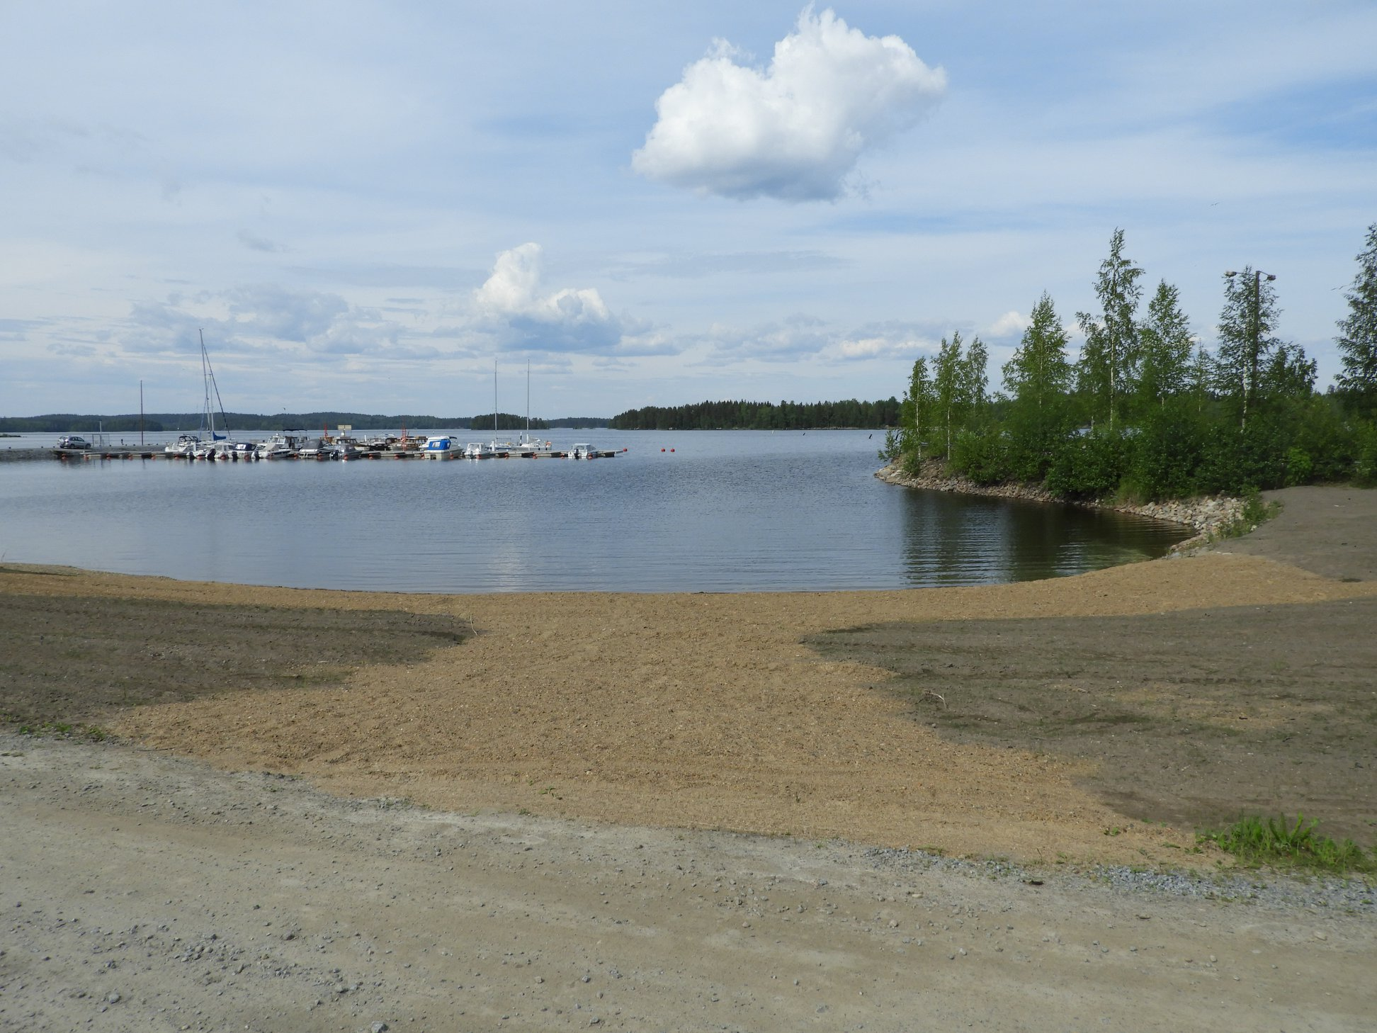

Slide 7
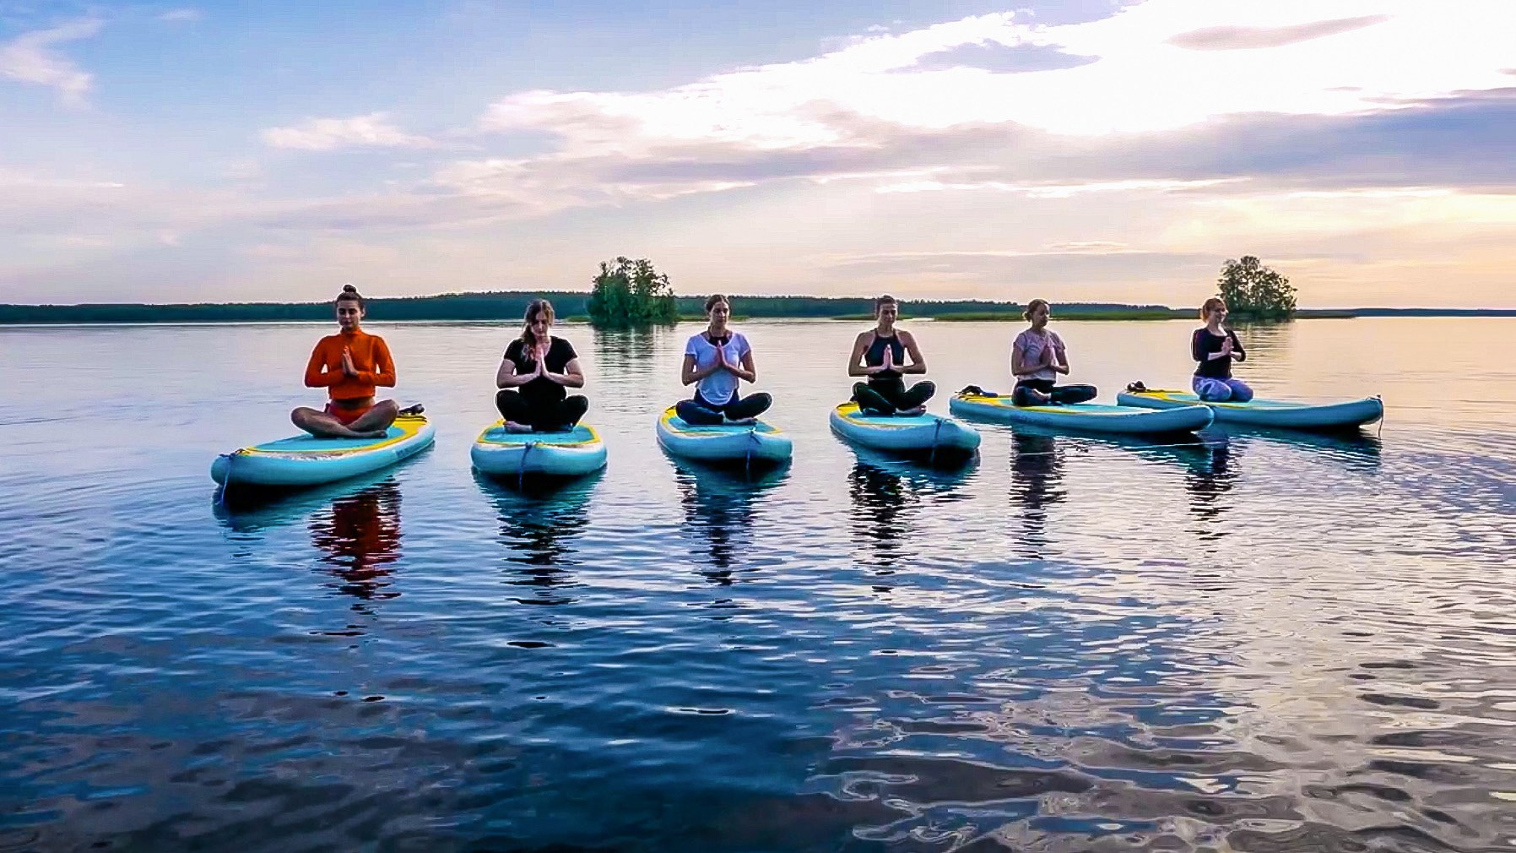

Slide 8
Rantasalmi High School
Small school: ca. 60 students
One third of students come from other towns
Every graduate will get a grant of 500 euros
The best high school of the region in 2021 based on the results of national matriculation examination
https://www.is.fi/kotimaa/art-2000008027931.html

Slide 10
Lines of study
General High School
Music Theatre
Studio Technique
Travelling and Internationality

Slide 11
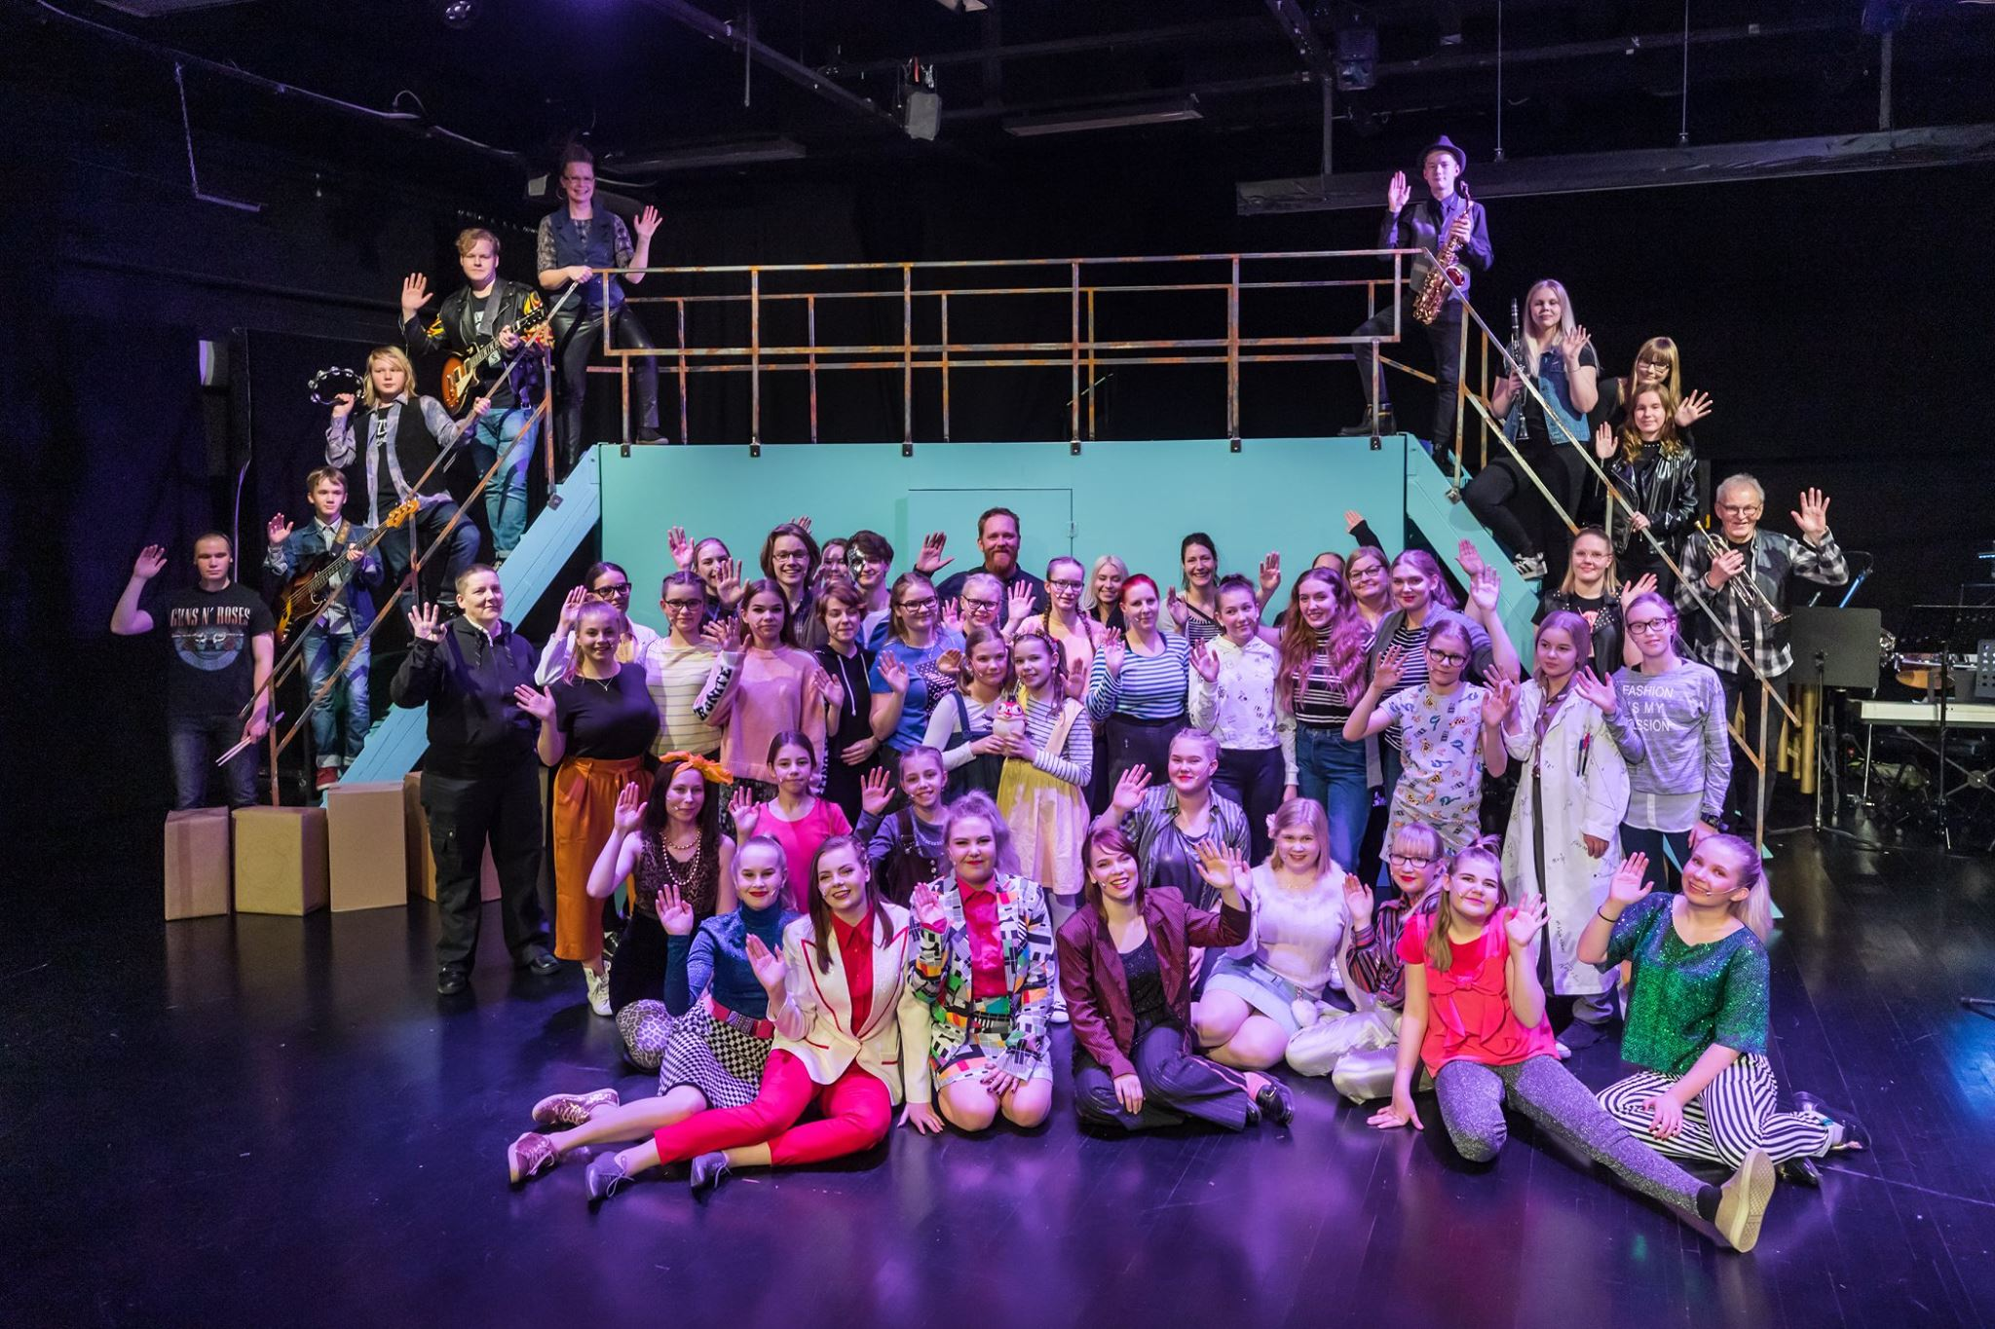

Slide 12
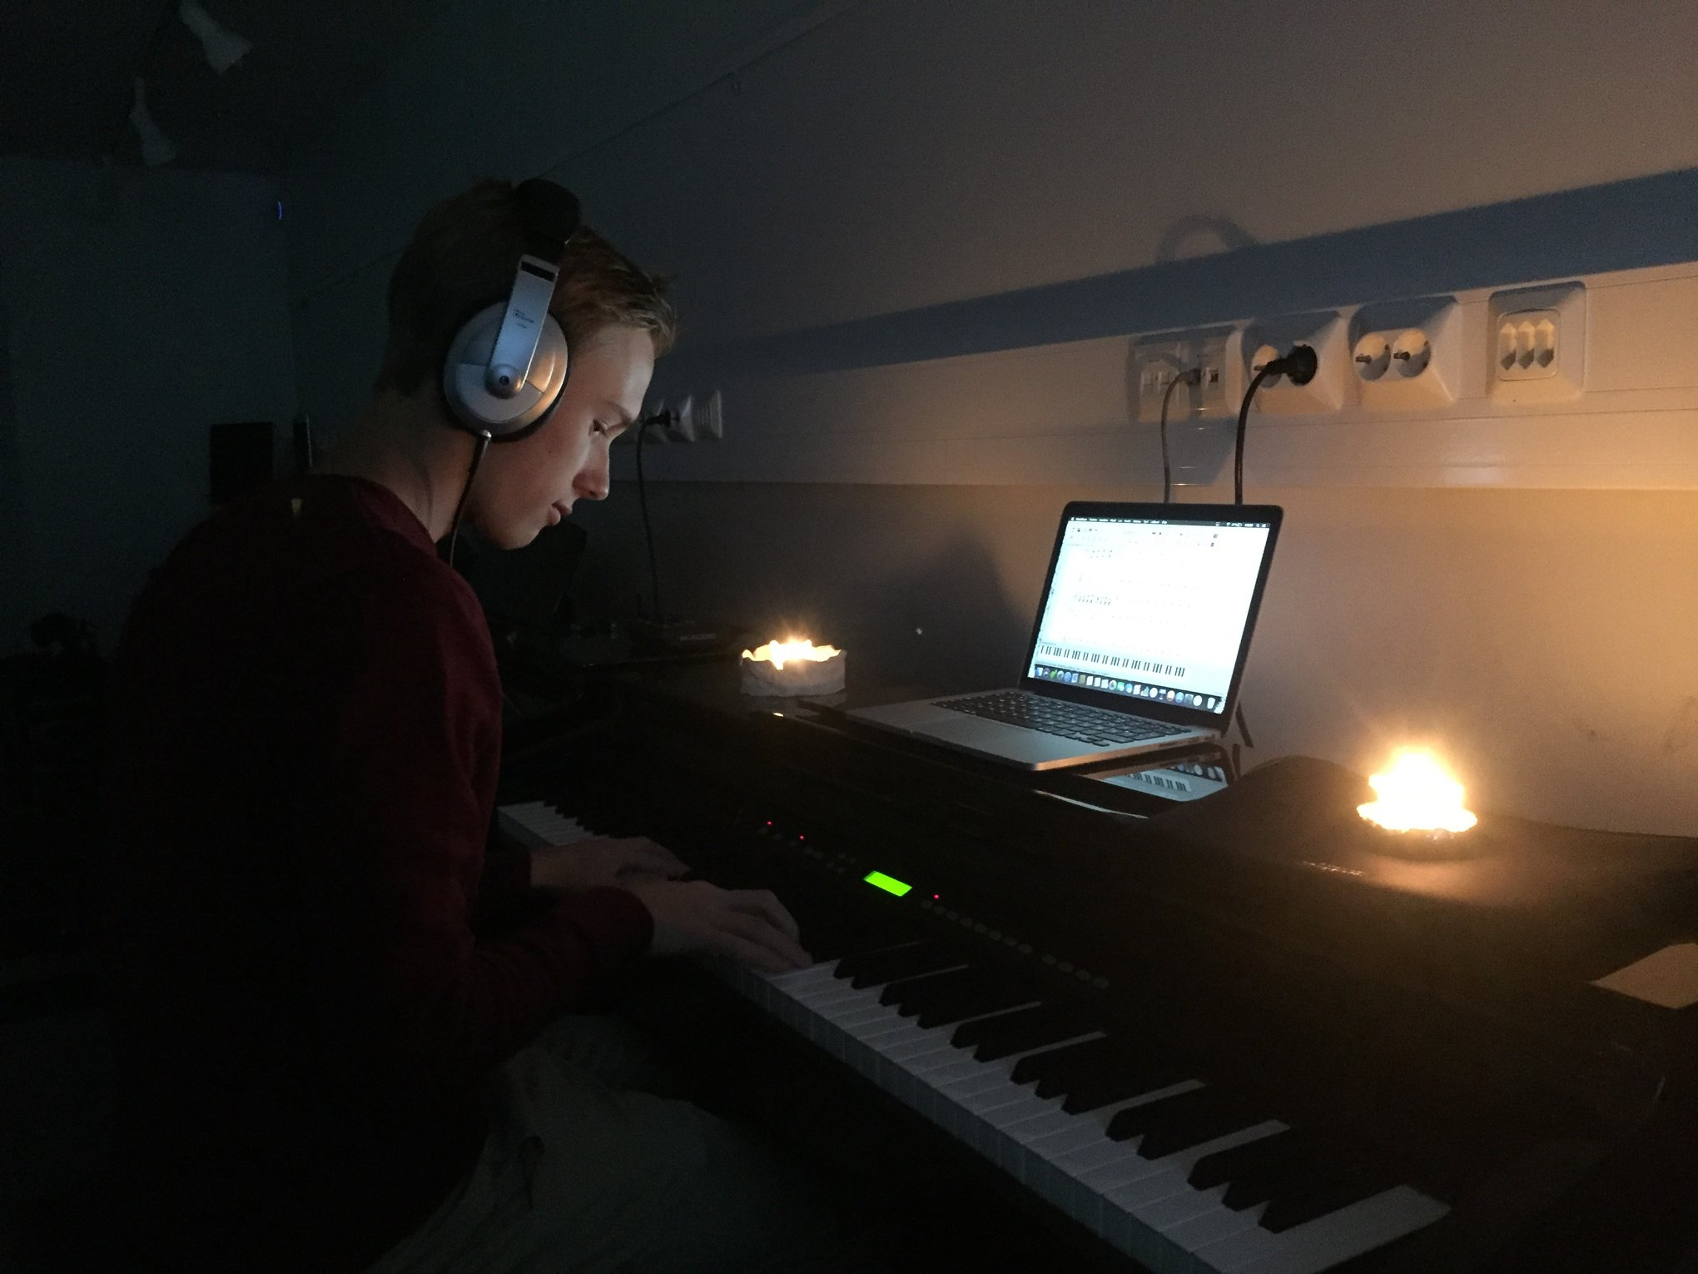

Slide 13
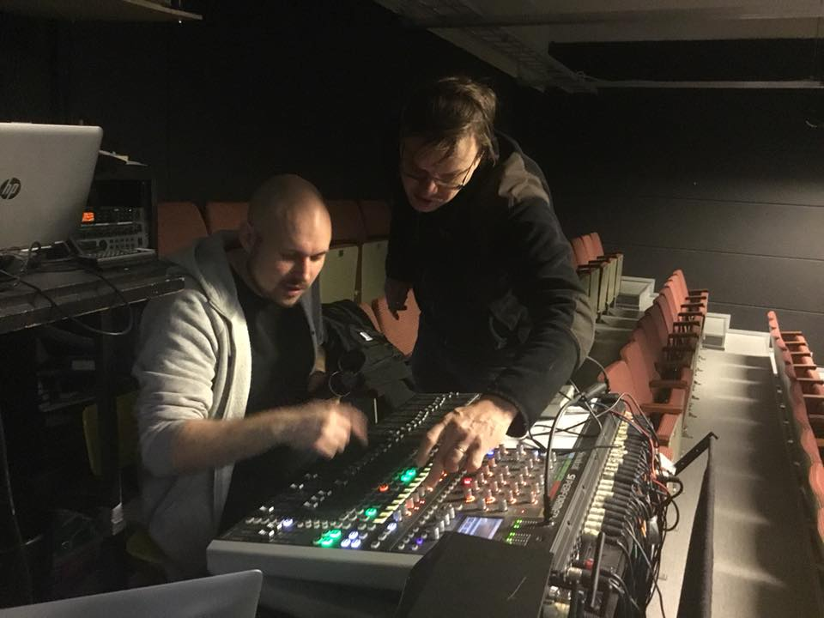

Slide 14
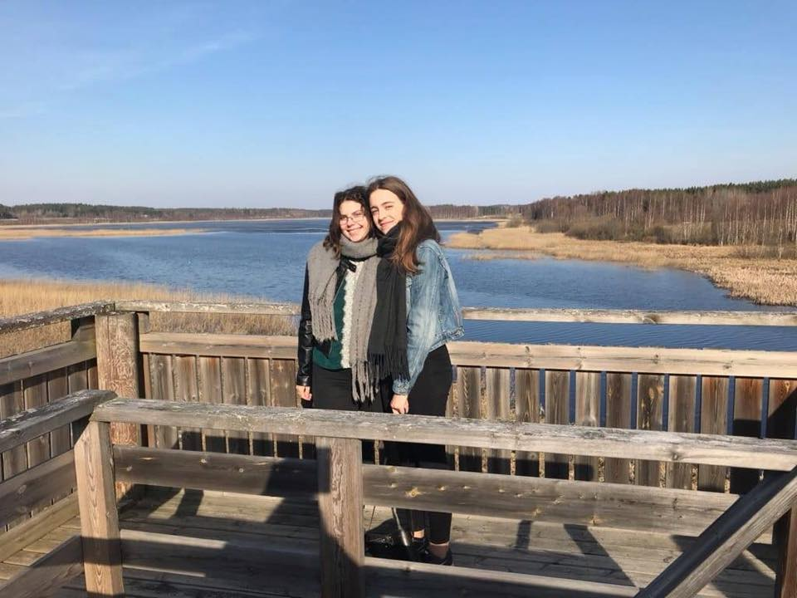

Slide 15
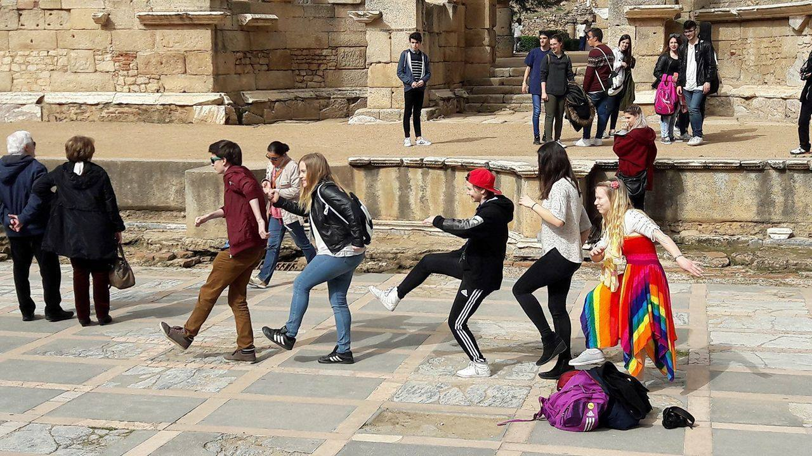

Slide 16
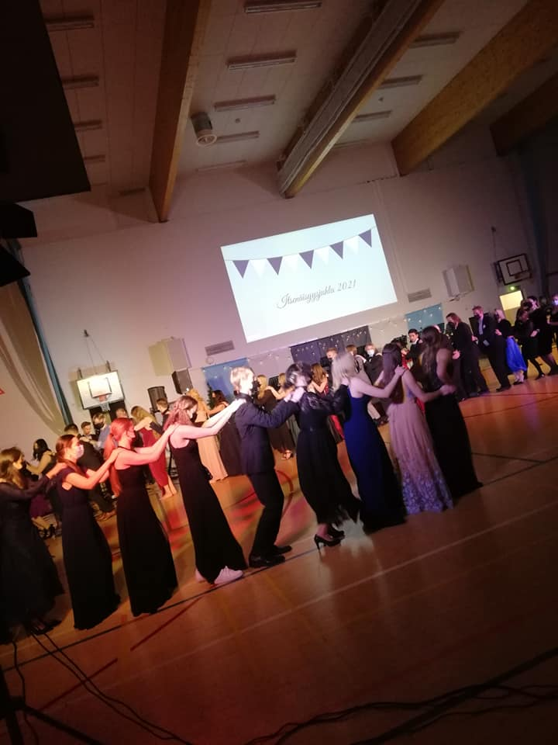

Slide 17
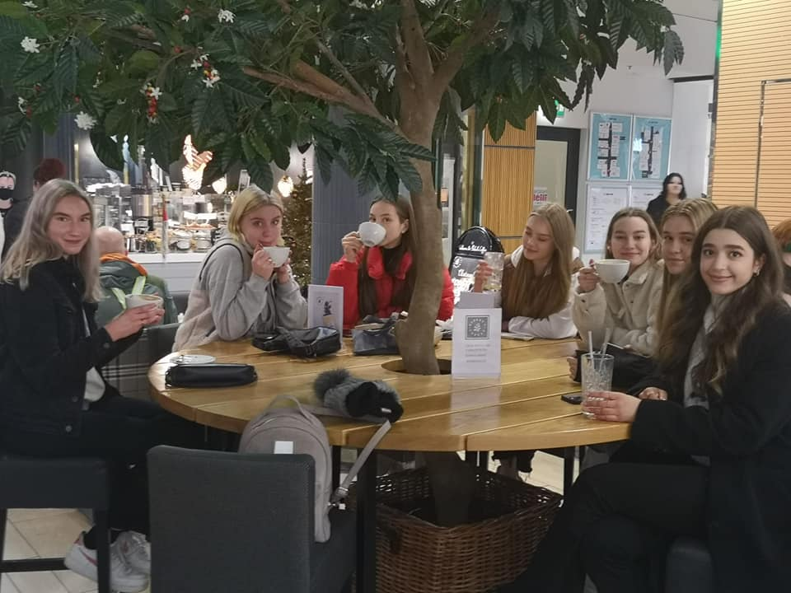

Slide 18
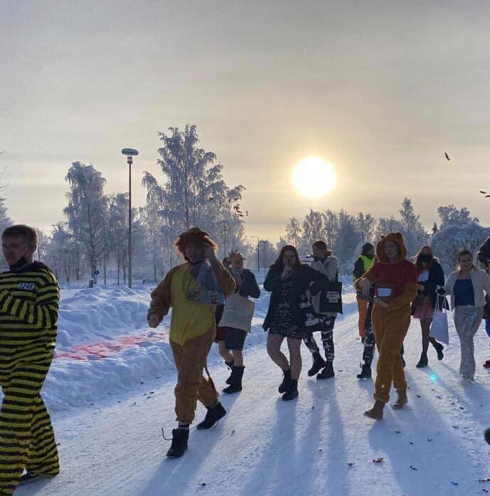

Slide 19
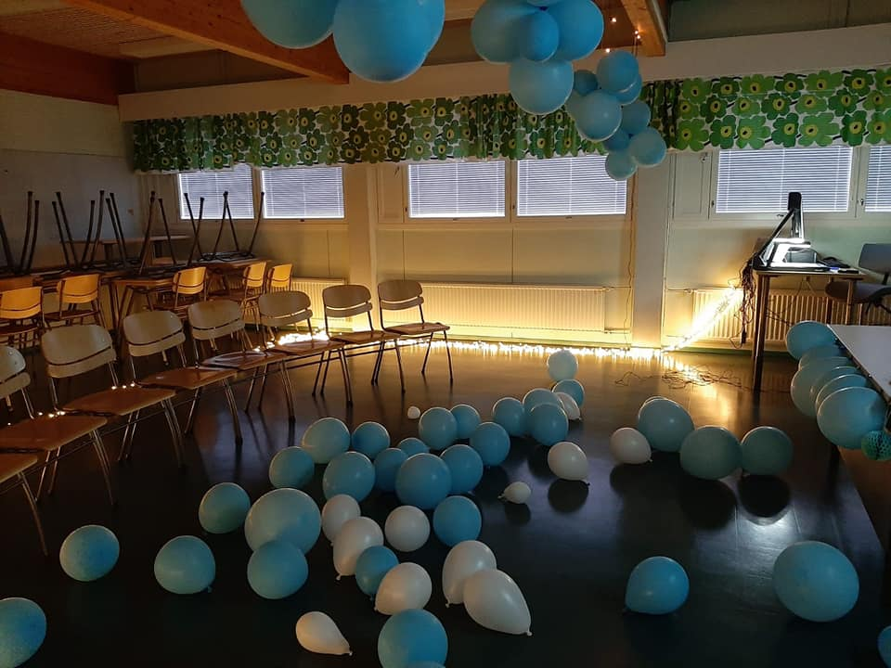

Slide 20
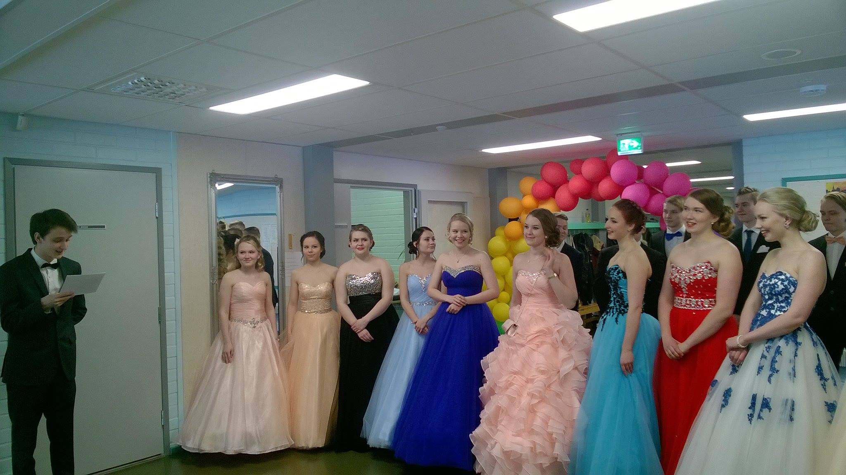

Slide 21
The subjects
At every high school you must study: Finnish, English, mathematics, physics, chemistry, biology, geography, history, psychology, philosophy, social studies, religion or ethics, health education, visual arts, music, physical education
At our school you may choose extra subjects: French, Russian, German, music theater, studio technique

Slide 22
Student support
Remedial instruction is available
Study counselor, school social worker and school nurse work at the high school every day
School psychologist is available

Slide 23
After high school
ANY university is possible to apply
Our graduates study e.g. in Helsinki, Jyväskylä, Oulu, Tampere, Kuopio, Joensuu and Lappeenranta
economic science, politics, bioscience, engineering, medicine, pharmacology, first aid, foreign languages, geography, forestry, music, music theatre etc.

Slide 24
Accommodation
Student rooms costs 150 euros per month
3-7 rooms per apartment + kitchen, bath room, (sauna) together
Very near the school and the center, max 1 km to walk
Possible to have a fully furnished room

Slide 25
Free time
Music theatre
Wind orchestra, private lessons in several instruments and singing (for actors)
Gym – free for new students
Ice rink
Sports field
Tennis
Jogging routes
Fitness stairs
Ski paths
Ice skating
Library
Youth house

Slide 26
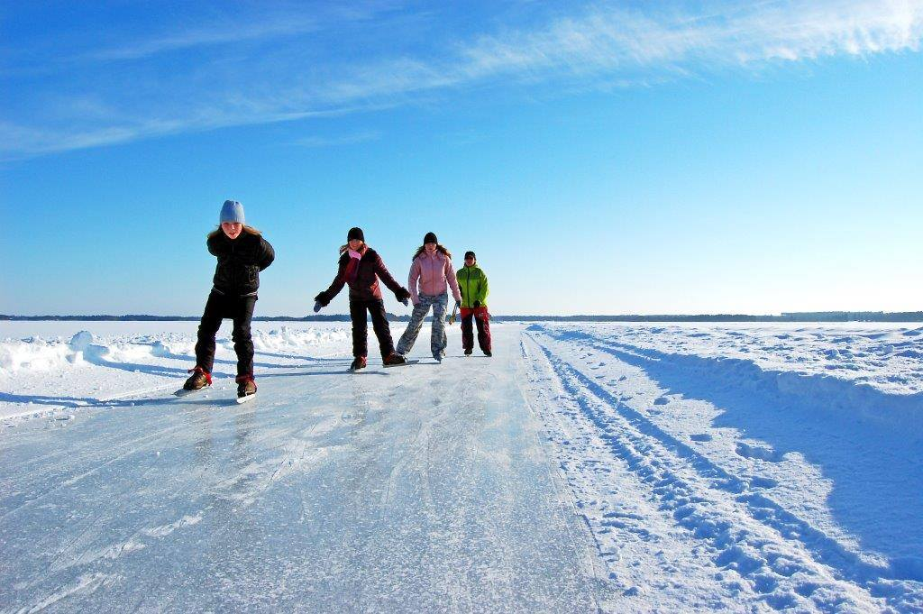

Slide 27
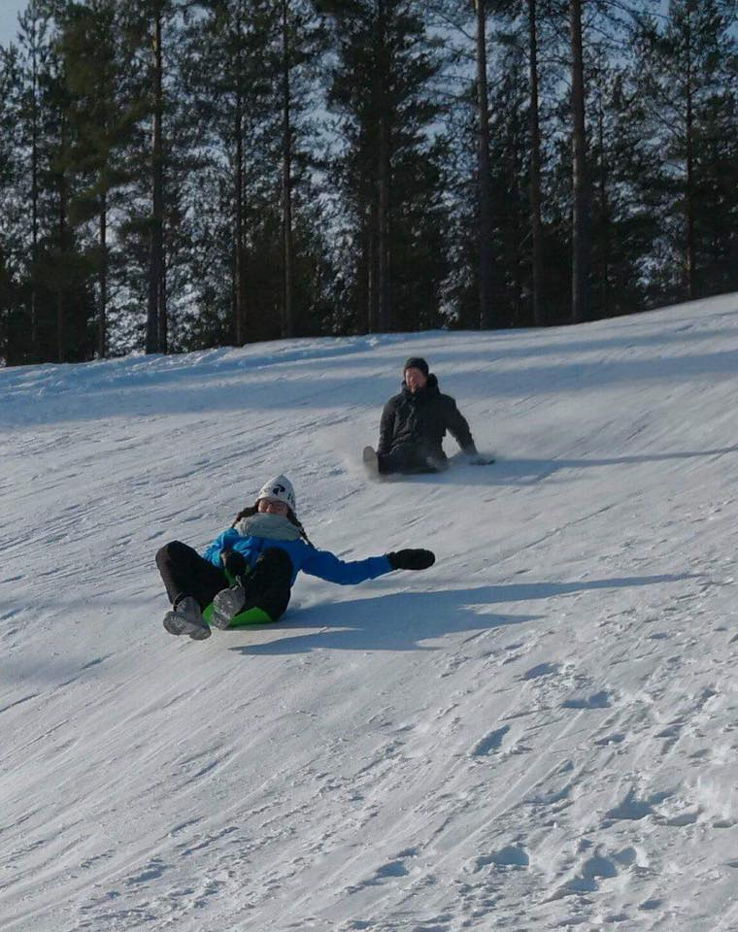

Slide 28
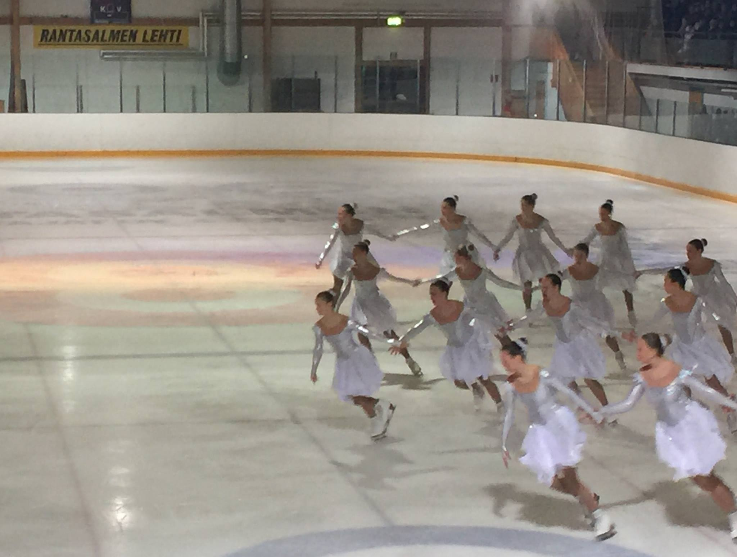

Slide 29
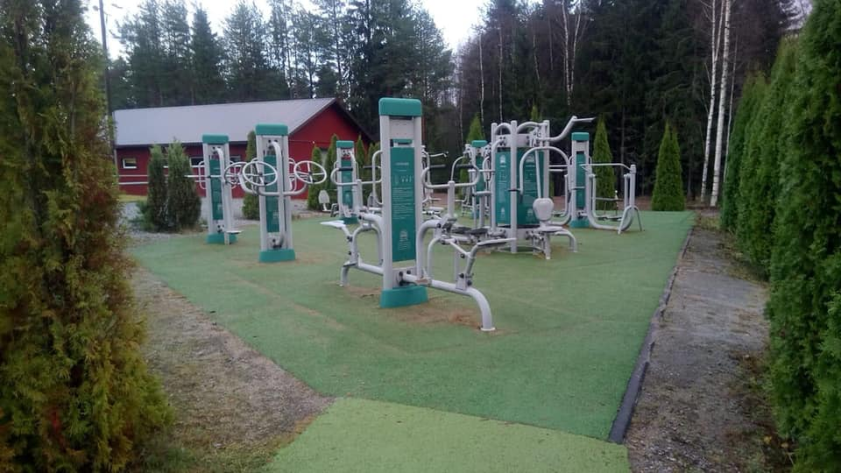

Slide 30
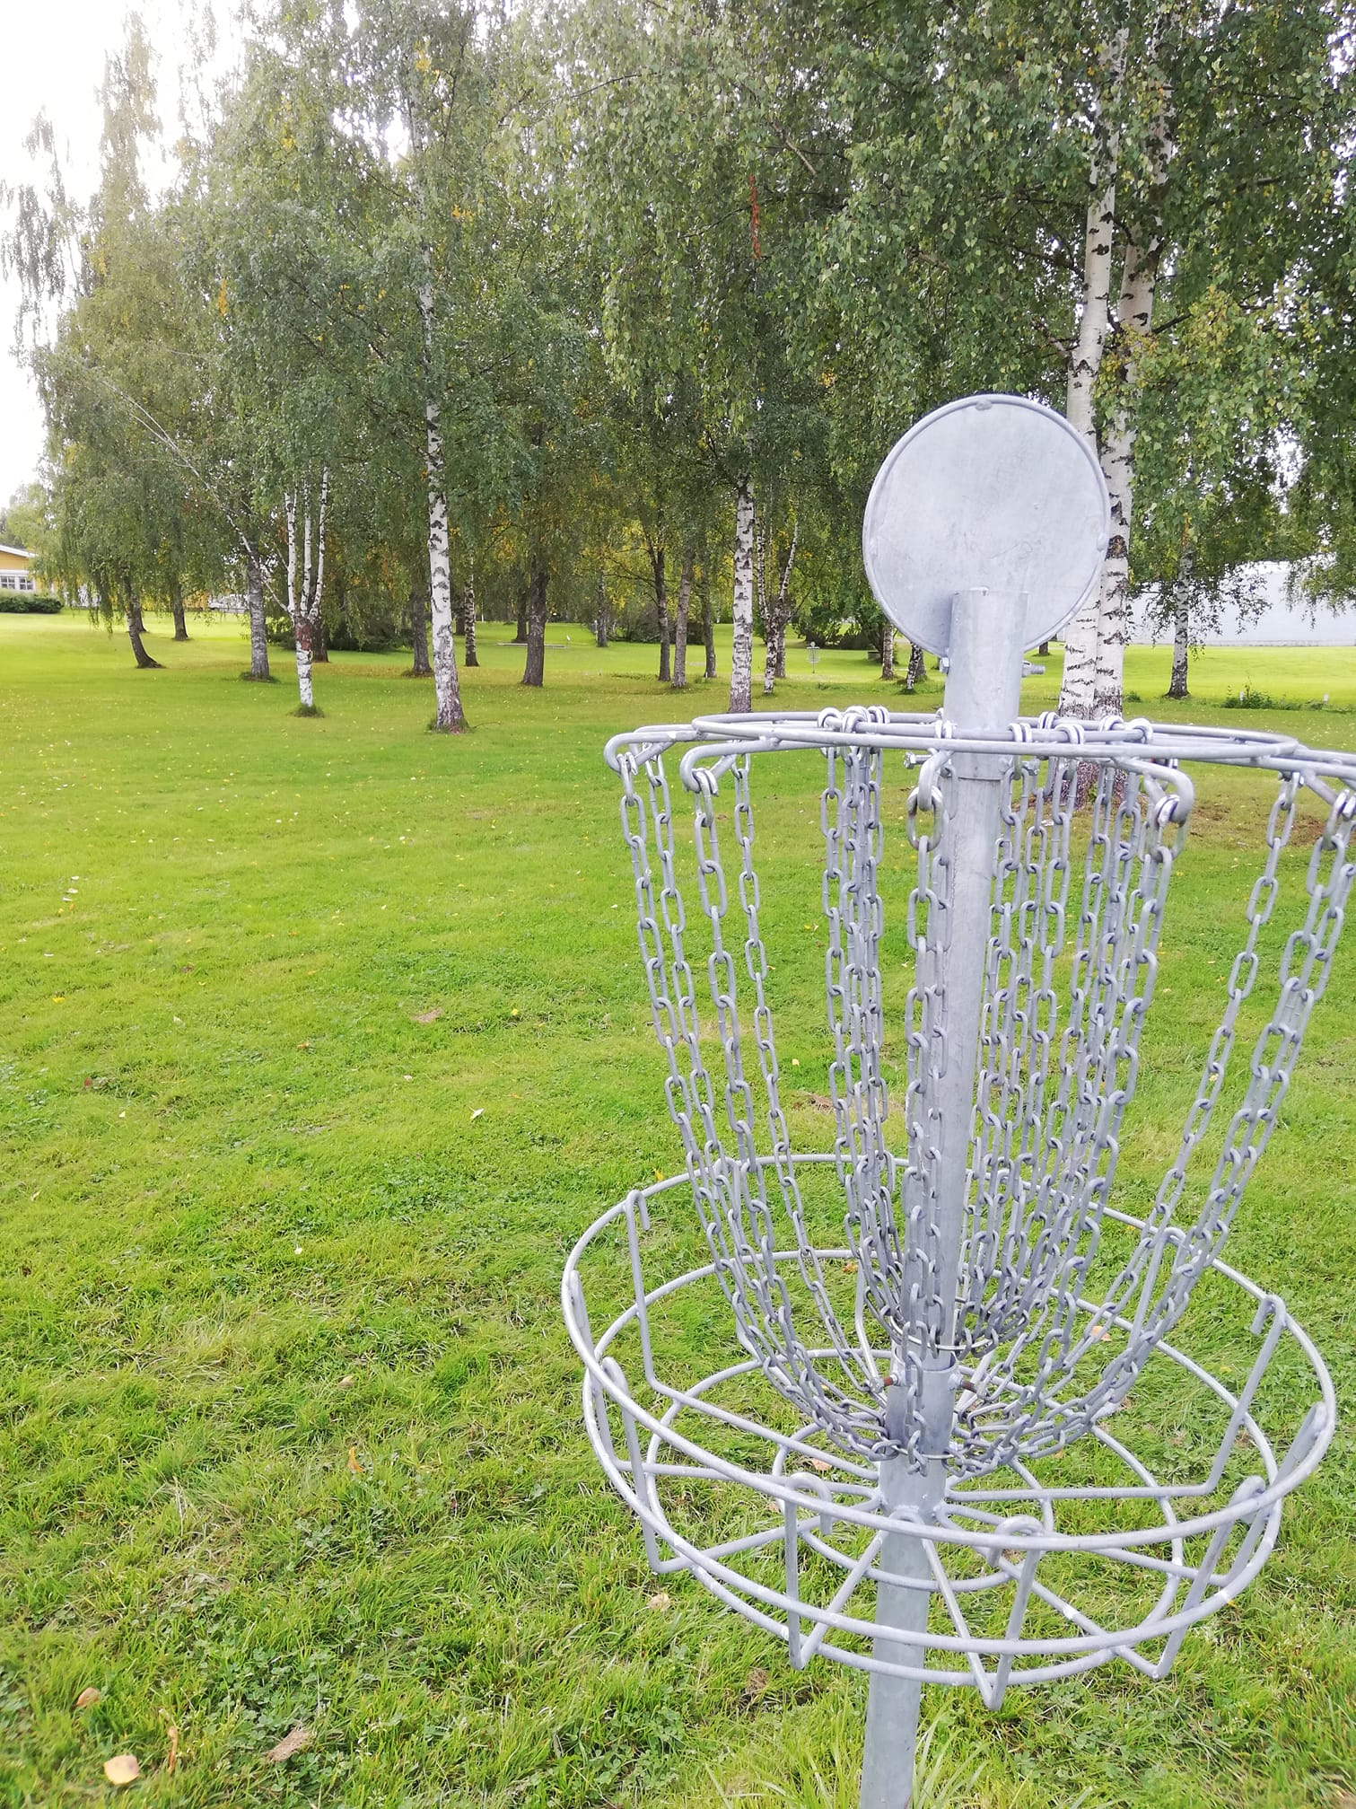

Slide 31
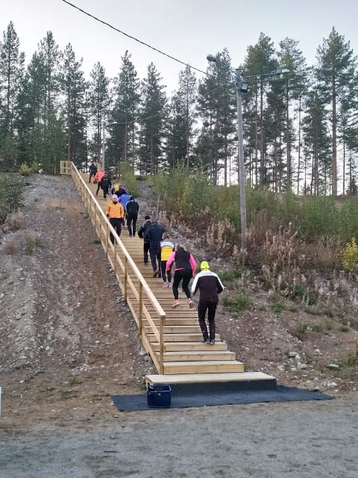

Slide 32
WELCOME!

